Slide 1
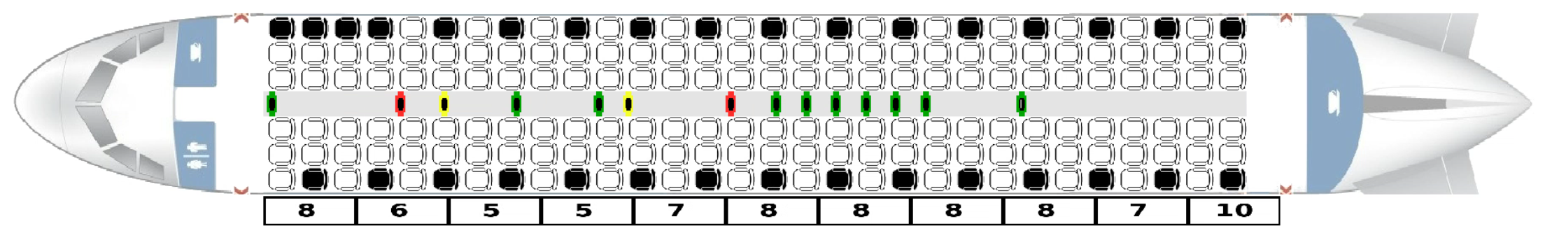
Airplane Boarding
Analysing different boarding methods using an agent-based model
Notes:
-10 seconds

Slide 2
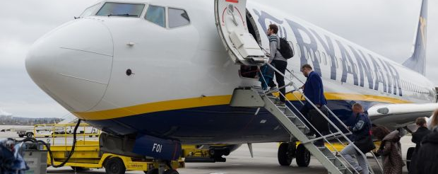
Introduction
https://www.irishtimes.com/business/transport-and-tourism/ryanair-punctuality-worsens-as-complaint-volumes-increase-1.3182401
Notes:
Relevance:
Business model budget airlines
More efficient use of planes and gates
Economical benefits
Minimizing Turn Time
Boarding as a main bottleneck
Boarding is often inefficient
How can we optimize?
Next slide methods and beus
Time: 30

Slide 3
Literature
“Reducing passenger boarding time in airplanes: A simulation based approach” H. Van Landeghem, A. Beuselinck - 2002
Agent-based model
Average plane
Compares different boarding methods
“Optimal boarding method for airline passengers.” J. H. Steffen - 2008
Proposes new boarding method
Supposedly fastest
Notes:
30 seconds

Slide 4
Main Contributions and Impact on Community
Implementation of an agent-based model
Configurable
Animation
Reproduction of Van Landeghem’s and Beuselinck’s results
Comparison of various boarding methods
Verification that Steffen is fastest
Exposing “alternation” as a key factor
Analysing impact of luggage load
Notes:
Agent based model
Python
Models passengers’ behavior in aisle/plane
Airplane and passengers can be configured
Animation included to see what happens, new insight on reasons
Reproduce Van Landeghem and Beuselincks results
See if our model valid
Base to our model
Compare the effectiveness of various boarding methods
On two commonly used short haul planes (in swiss fleet) (because there turn time most relevant)
With different passenger loads
(Total boarding time, average individual boarding time)
We verify that steffen is fastest method
Find important factors
Find that boarding methods with sensible choice of alternation parameter are most efficient. Explanation later
Provide analysis of the impact on luggage load. (Important for planning boarding cost efficient, price of hand luggage? Reduce amount of carry on luggage higher prices => more profitable?)
MENTION IMPACT ON COMMUNITY
SPRICH UEBER DEN TITLE< ALLES KLAR MACHEN, OK COOL
Time: 90 seconds

Slide 5
Challenges
Choosing the right abstractions
Plane
Luggage
Passengers
Movement
Passenger interaction
Passing each other in aisle
Notes:
We faced challenges when building our model
Choosing where to abstract and what to take into account
Features plane
How model luggage
How design agents
How model movement in aisle
Especially decisions how to model interactions of agents, e.g. when they pass each other in aisle
Time: 30 seconds

Slide 6
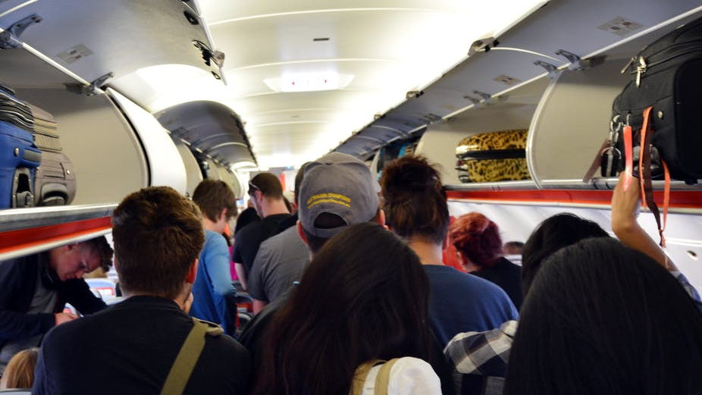
The Model
https://images.theconversation.com/files/65277/original/image-20141124-1034-fqtt8l.jpg?ixlib=rb-1.1.0&q=45&auto=format&w=926&fit=clip Date Accessed: 8.10.18

Slide 7
The Model
Models passengers’ behavior in plane
Agent based model
Agents move in the one dimensional aisle
If not switching positions, 2 agents never occupy same space in aisle
Agents act once per timestep
Notes:
Models passengers’ behavior in plane
What happens outside not relevant
But determines order in which they arrive at door
Passengers arrive at door in certain order (by seats)
Agent based model, agents = passengers
Move in aisle which has only one dimension in implementation
Aisle narrow, so never two next to each other unless moving in opposite directions and need to switch positions
Discrete time steps. In each step each agent in aisle acts once
Acting dependent on state they are in
Behavior like fsm
Time: 45 seconds

Slide 8
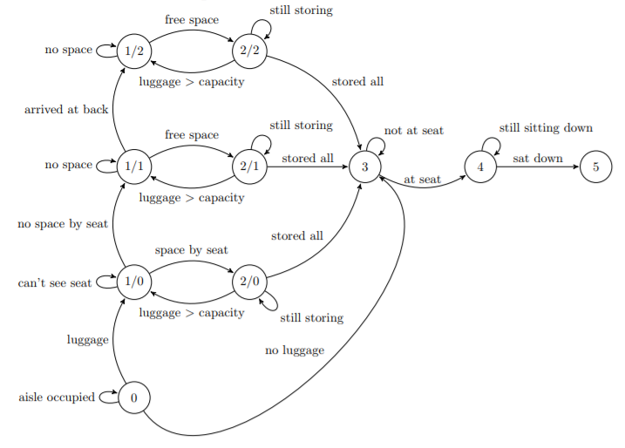
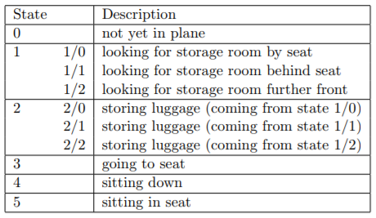

The Agents
Notes:
All agents start in state 0
Enter plane when
there is enough space in the aisle
They are next in order to board
If no luggage then advance to seat directly
If luggage need to store first
Time: 120 seconds

Slide 9
The Agents
Notes:
State 1/0 looking for storage room by seat
First try to store luggage by seat
So walk to seat, if cant see seat -> stay in same state and continue walking (passengers have fov)
When seeing compartment at seat
If not enough space to store all, store at next available, so advance to state 1/1
If free space FOR ALL PIECES, go there and store luggage
Storing works the following
Each passenger has unique time they need for storing 1 item
Mark as much space as occupied as they need for storing items
Stay in storing state until stored as many items as possible (#timesteps determined by storing time)
When stored all items go to seat (state 3)
If could not store all, go back and continue searching for space

Slide 10
The Agents
Notes:
When see that cannot store all items in compartment at seat -> advance to state 1/1 searching for storage room anywhere (CORRECT TABLE)
Walk forward as long as not at compartment with free space
When arrive at compartment with free space, store as many items as possible
If cant store all, continue searching
If arrive at back of plane, turn around and continue searching -> state 1/2

Slide 11
The Agents
Notes:
Did not find free compartment
We do not allow more hand luggage in the plane than compartment space
Because handled at gate, stewardesses count
So ahs to be more free space
Further front that we walked by before at seat
So walk towards front of plane and store if can

Slide 12
The Agents
Notes:
When storing all luggage
Passengers move to seat
Each time walk in direction of seat
When at seat sit down (state 4)

Slide 13
The Agents
Notes:
Before being seated, stay in state 4 for #timesteps, still blocking the aisle
Just the time it takes them to move into row if noone blocks way
If people seated between them and their seat, time it takes them to move into row + time it takes others who need to move out to exit and enter

Slide 14
The Agents
Notes:
When seated, done
Not acting anymore
When all seated, done

Slide 15
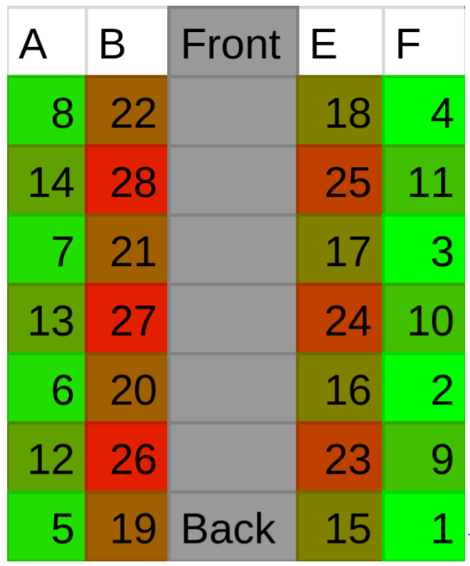
Boarding Methods
Boarding method defines order on seats
Individual seats
Blocks
Commonly used: random, by block, by letter
The Steffen Method
Window to aisle
Back to front, skipping 1 row
Alternation of n means skipping n rows
Notes:
Boarding methods determine order in which passengers board the plane depending on where seated. Boarding methods define order on seats.
- Some define order on all seats
Usually airplane divided in blocks then, order defined on block
All people in one block enter before all people in other block
People in same block board in random order
Used in practice: random , passengers board whenever they want, block blocks nr on boarding pass, or letter on boarding pass, boarding agent announces, when which group can board
Steffen method defines order on single seats
From window to aisle boarded first
From back to front. But 1 row skipped so passengers don’t block each other
Explain image
See in simulation animation later
We call this skipping of rows alternation. Board back to front skipping n, n alternation. Here 1 (steffen)
Time: 60 seconds

Slide 16
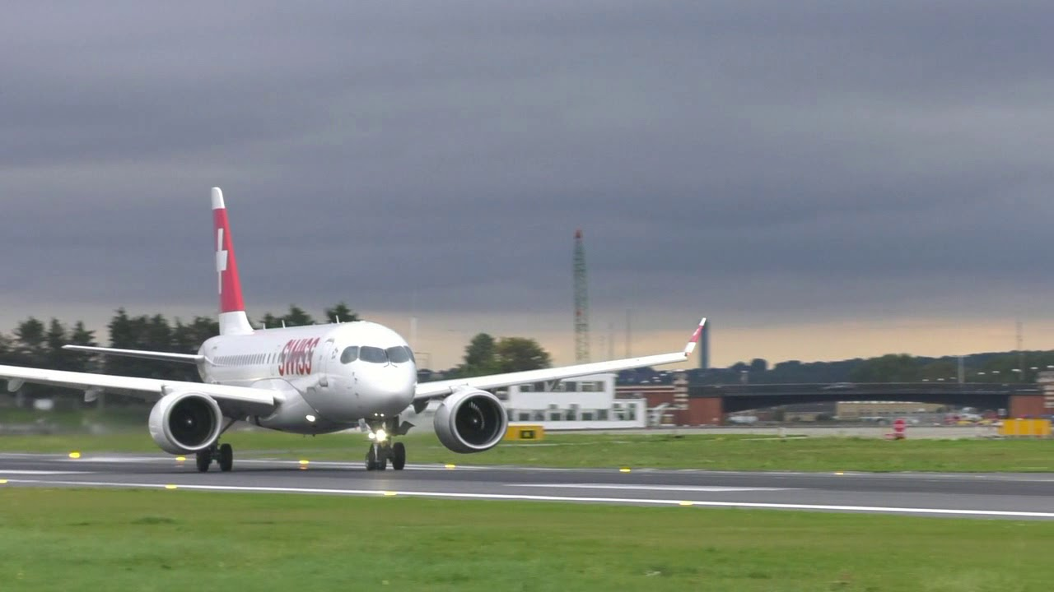
Results
https://www.youtube.com/watch?v=oLCViWPbugM

Slide 17
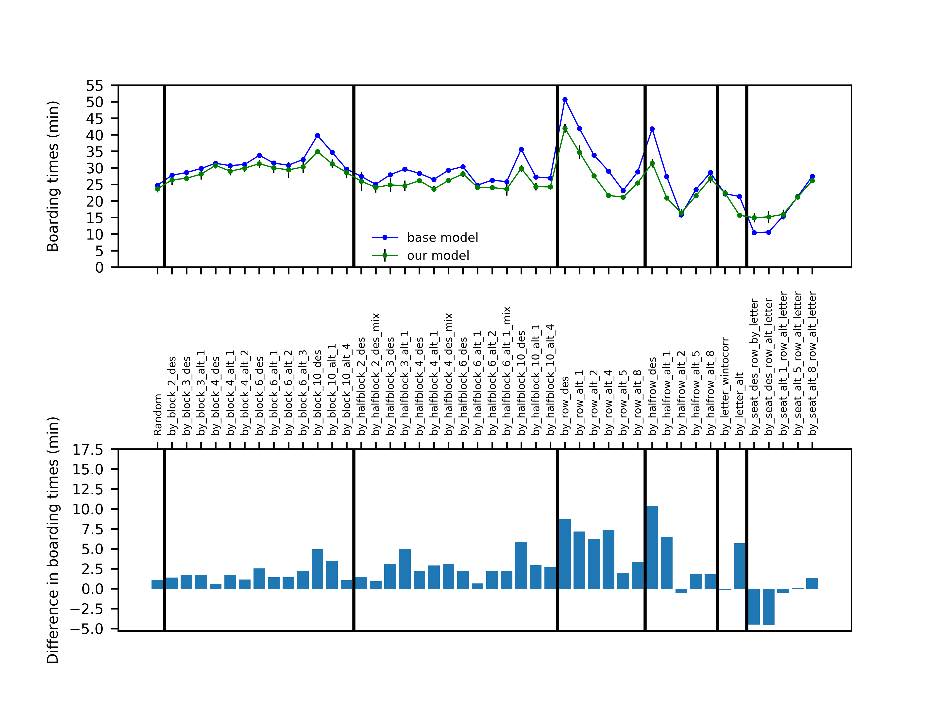
Our Model vs. Van Landeghem’s and Beuselinck’s Model
Notes:
Similar airplane, 23 rows and 6 seats per row (skip)
Passenger load level at 100% (skip)
Luggage load level in our model is set to 90% (normal load for a full airplane) (skip) (Sag einfach same conditions)
5 Trials for each boarding method (Error bars 95% confidence interval)
Our boarding times are generally lower.
Probably because of the different ways luggage is handled
In our model the time it takes to store luggage does not increase the fuller the compartments are
Fewer pieces of luggage in our model
General relations between methods are preserved
Time: 45 sec

Slide 18
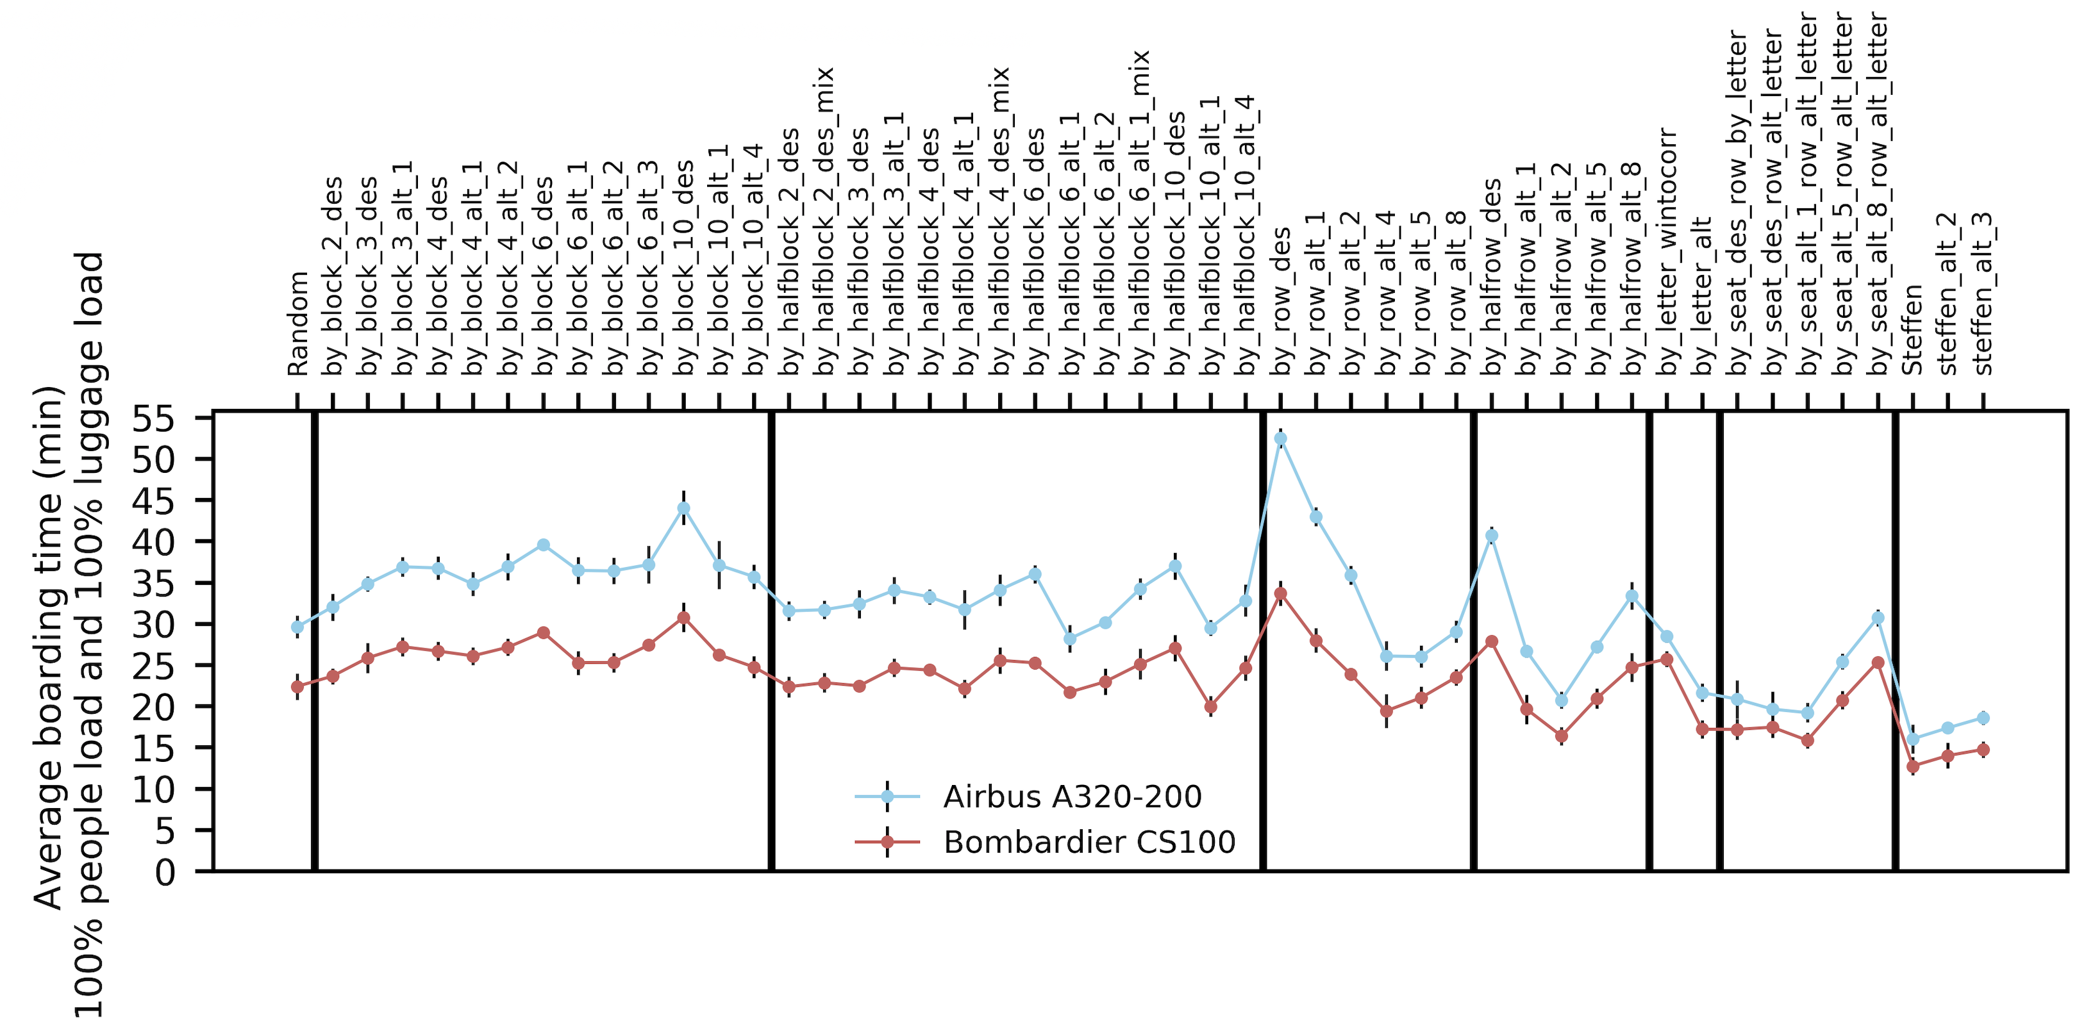
Different Boarding Methods - Airbus A320-200 & Bombardier CS100
Notes:
Planes
Airbus A320-200:
Commonly used big short-haul plane
Classic symmetric seat arrangement
Bombardier CS-100:
Smaller than the Airbus
Asymmetric seat arrangement
Comparison between the boarding times of the two planes:
There is obviously a size difference
Asymmetry did not have a noticeable effect on boarding times
But the difference in boarding times for different methods are more significant, therefore the chosen boarding method is more important for bigger airplanes as it has a greater effect
Real world impact
General information:
Steffen method performs the best across all other methods for both planes, around 42% faster than the most commonly used method Random
Nevertheless Random performed surprisingly well and is around the average time across all methods testet
Furthermore random performed 4% faster than the fastest by_block version (these methods are commonly used on long haul flights)
Contribution: Block boarding should not be used in the real world for short haul flights, different with bigger airplanes (multiple aisles etc.)
Time: 90

Slide 19
The Alternation Effect
Notes:
Alternation plays a very key role in the efficiency of methods and can cause significant differences in experienced boarding times.
We noticed that for methods which differentiate themselves from each other only in the alternation, the boarding time first decreases with an increasing alternation and then starts to increase again.
This is most noticeable for the class by_row
Key reason is the number of aisle congestions caused by agents storing their luggage or sitting down.
Alternation decreases the number of row congestions between people from different rows at the expense of space in the aisle. When we start to increase alternation, there will be more space in the aisle between agents that sit in different rows up to the point where the two rows that follow each other in the boarding sequence can board concurrently, at this point the boarding time is the lowest, now any further increase in alternation will cause the boarding time to increase again because there will be empty more and more unused empty space. This causes the observed effect.
Contribution: Alternation can positively and negatively affect boarding time, so careful analysis is required
bting die scheisse auf den punkt
warum enabled alternation concurrent boarding
Time: 90

Slide 20
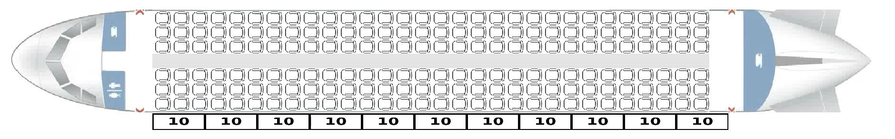

Steffen vs Random
Airbus A320-200, 100% Load, Speed: 50x Top: Random, Bottom: Steffen
Notes:
- Talk about different colours and what they mean
Random: 29 min
Steffen: 19 min
Concurrency is key for steffen
Time: 40

Slide 21
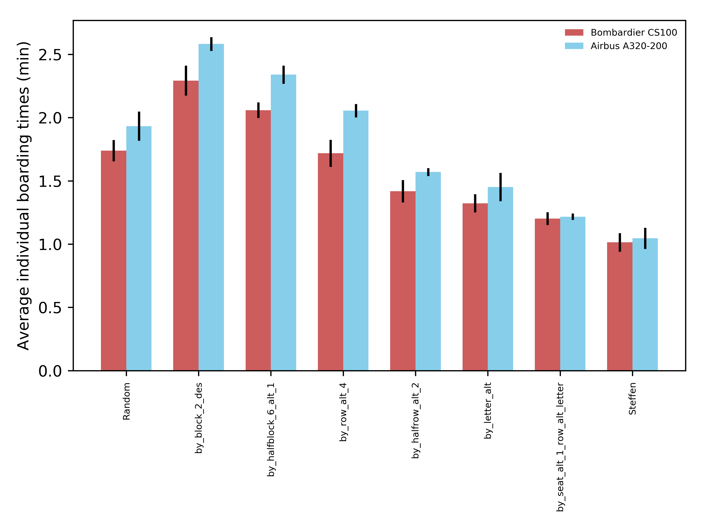
Individual Boarding Times – Bombardier CS100 & Airbus A320-200
Notes:
The faster the boarding method, the lower the average individual boarding time
Despite the very different plane configurations, the bombardier having a lot fewer seats than the Airbus, the faster the methods the closer the individual boarding times are together
This results in almost the exactly equal boarding times for the fastest method Steffen
The reason for that is that because due to the decreasing number of congestions, the actors are almost able to walk directly towards their seat in the fastest methods.
There is a strong correlation between the total and average individual boarding times, supported by the fact that the R^2 value is greater than 90%
For airlines this shows using a faster boarding method will result in faster individual boarding times
Time: 45

Slide 22
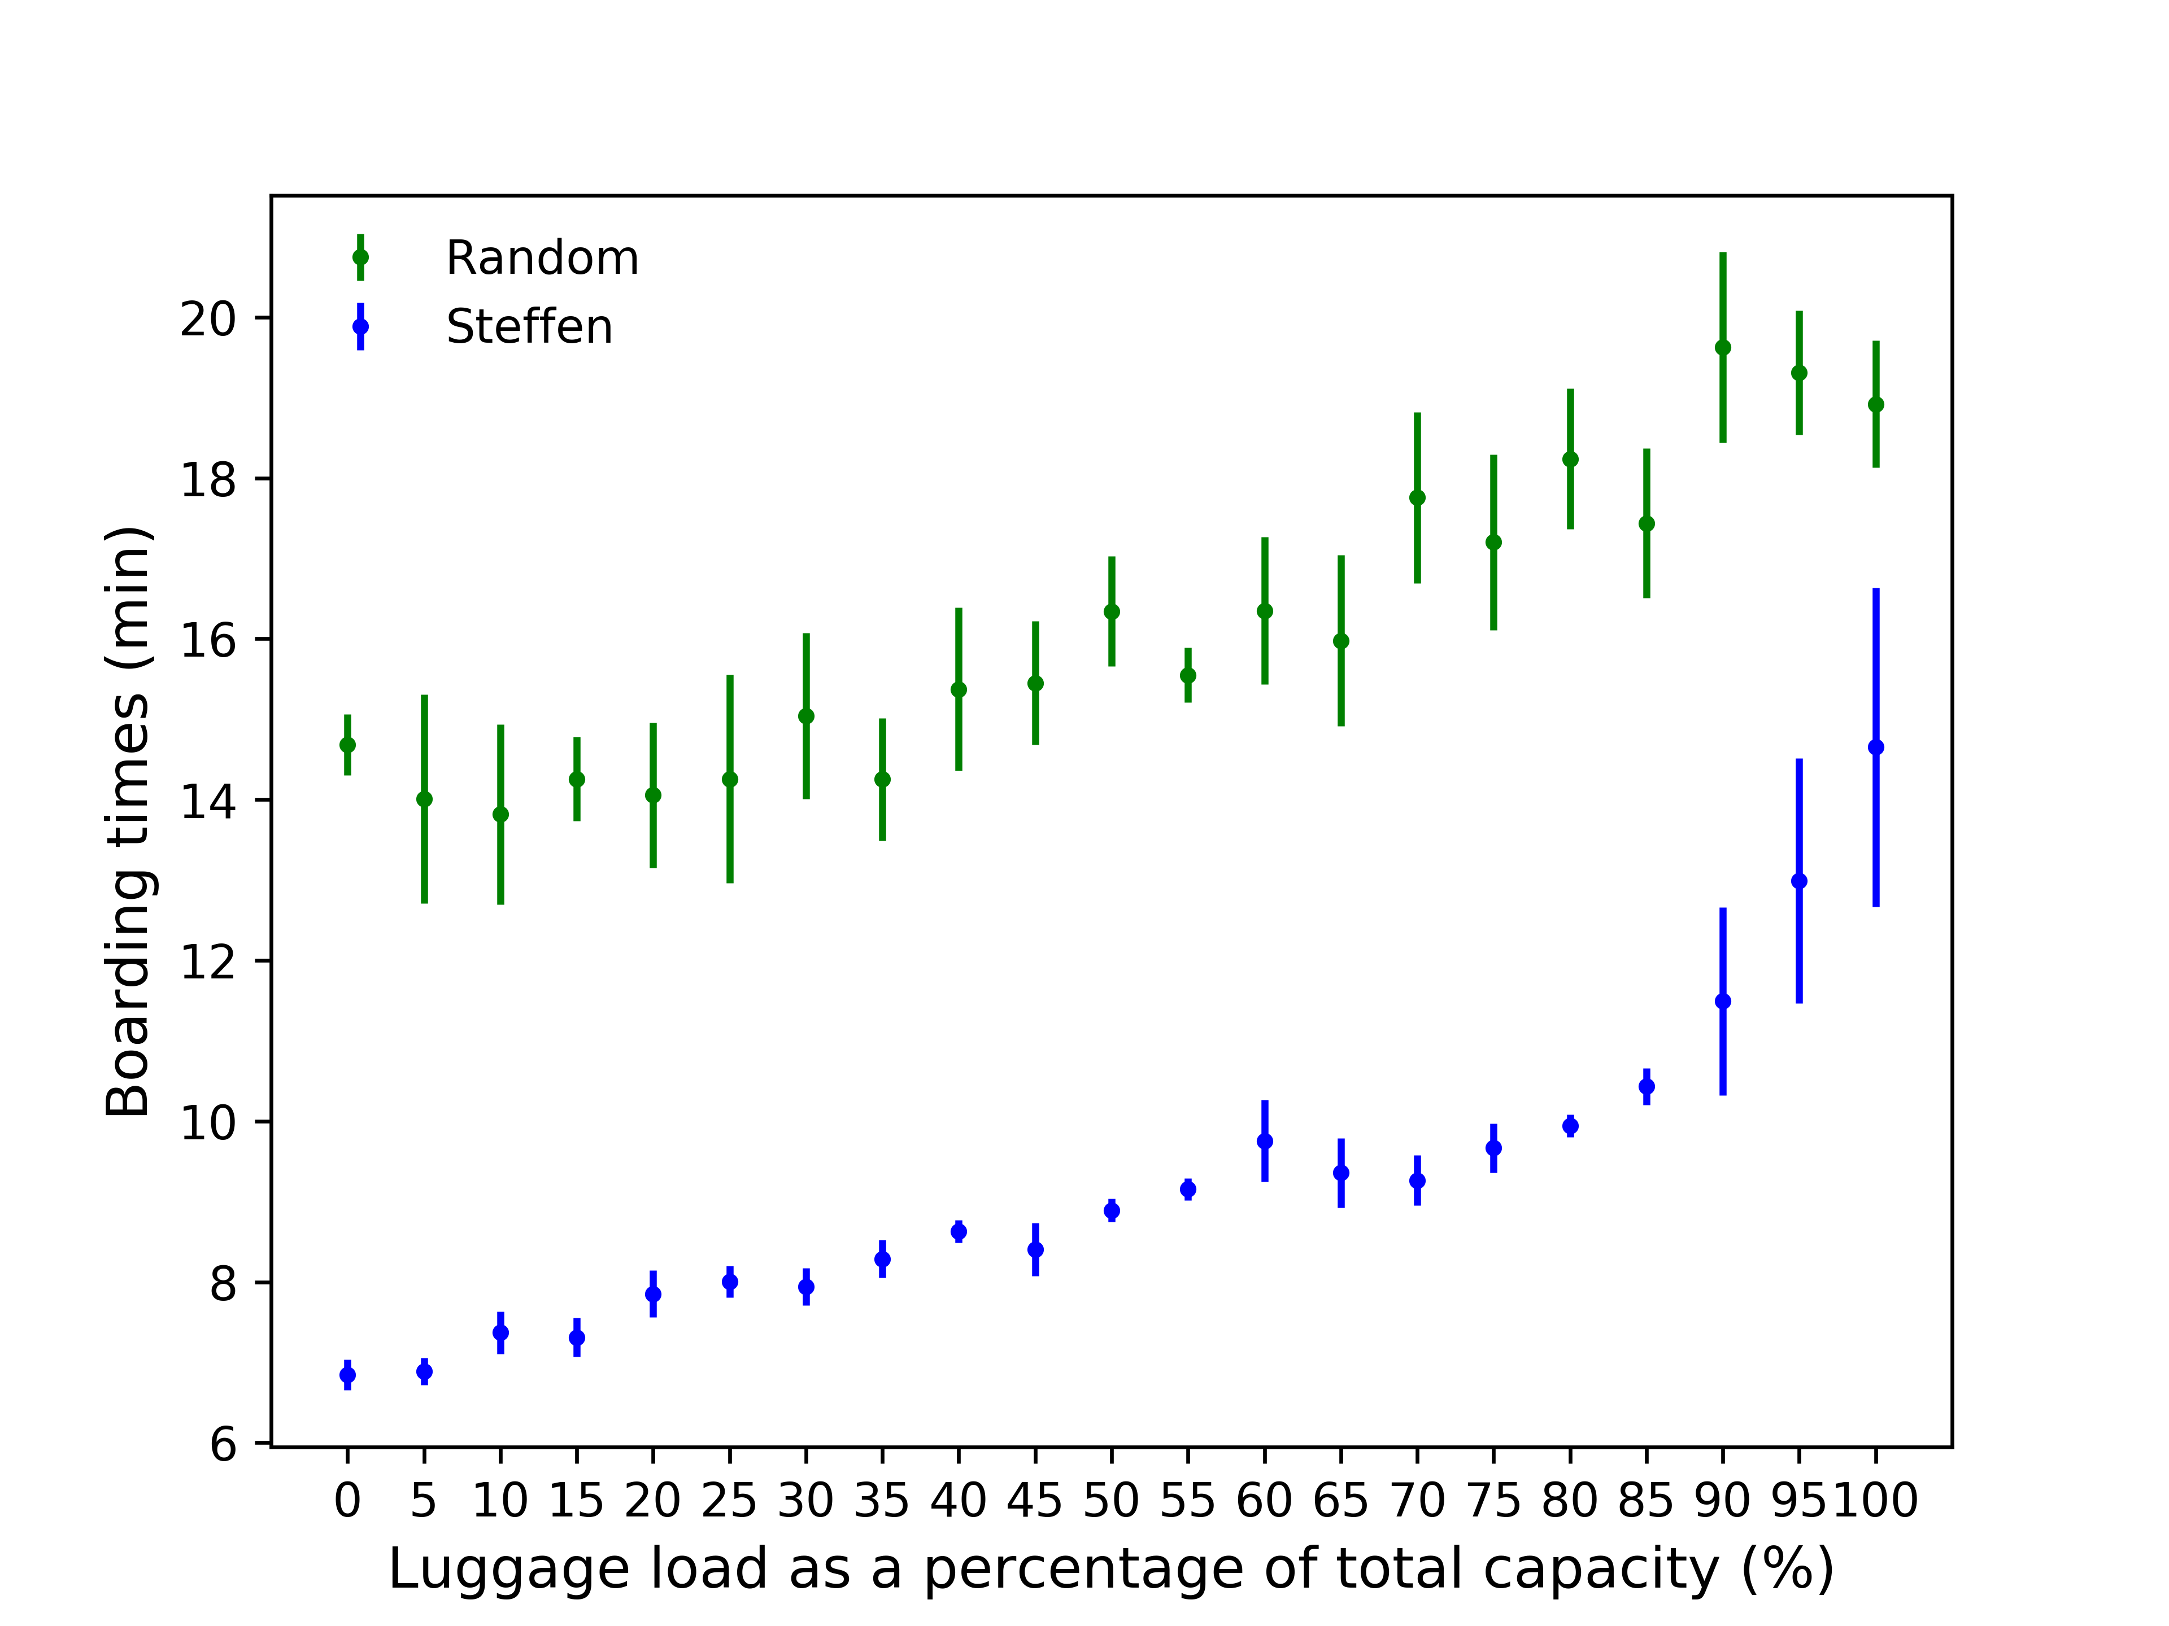
Effect of Luggage Load – Airbus A320-200 full Passenger Load
Notes:
Luggage has a greater effect on Steffen than on Random because there are generally almost no row congestions in the aisle caused by people sitting down, so greater effect of luggage interferences.
For random there is no general order that would avoid passenger congestions
This is also why the confidence interval (95%) increases for Steffen but remains at a constant level for random (general randomness)
Maybe some Contributions
Time: 30

Slide 23
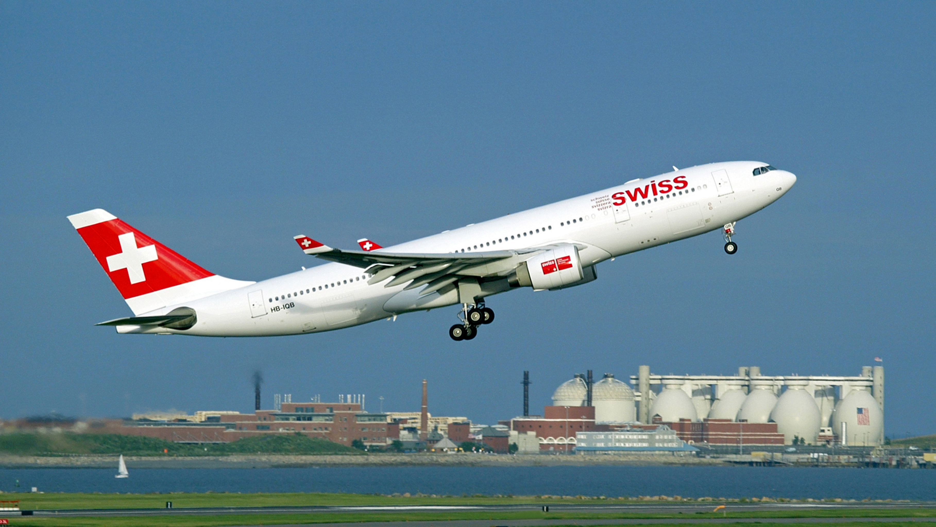
Conclusions
https://commons.wikimedia.org/wiki/File:Swiss_Air_HQ-IQB_A330.jpg

Slide 24
Conclusions
Our agent-based model accurately depicts reality
Aisle congestions are a major source for increased boarding times
Alternation effect as a mean of success
Steffen method is the fastest for overall and individual boarding times
Strong correlation between individual and total boarding times
Luggage load has a great influence on boarding time, especially for faster boarding methods
Notes:
Alternation enables concurrency.
- Conclusions were already mentioned in result analysis
Time: 20 ( 5)

Slide 25
Limitations
Mostly uniform actors
Constant time to store luggage
Boarding through one entrance only
Notes:
Uniform actors: personalaity, groups, sizes etc.
Time: 30

Slide 26
Outlook, Improvement and Extension
Additional attributes could be added to agents
Include planes used for long haul flights
Conduct experiments with humans
Notes:
Key attribute: travelling in groups
Two story planes, multiple aisles, multiple entrances
for the last point only say that it will give better data
Time: 30

Slide 27
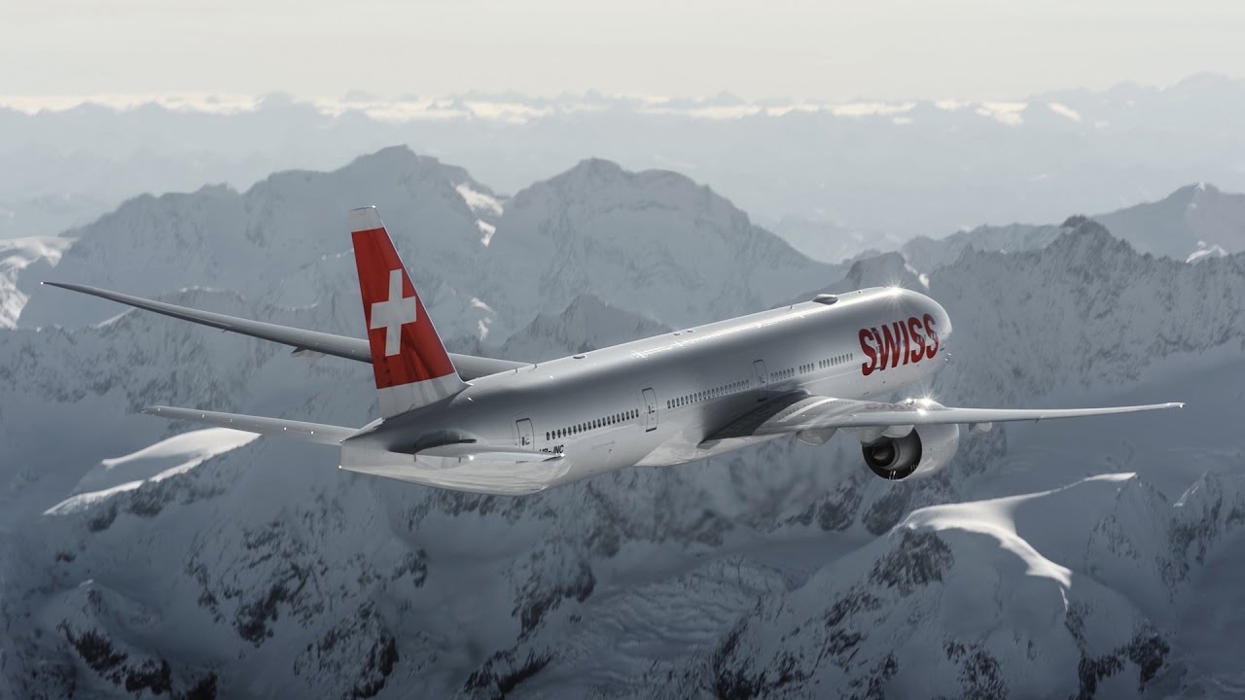
Q & A
https://www.youtube.com/watch?v=axQ0s-TYCGU

Slide 28
References
Literature:
Van Landeghem, H, and A Beuselinck. ”Reducing Passenger Boarding Time in Airplanes: A Simulation Based Approach.” European Journal of Operational Research, vol. 142, no. 2, 2002, pp. 294–308., doi:10.1016/s0377-2217(01)00294- 6.
Steffen, Jason H. ”Optimal boarding method for airline passengers.” Journal of Air Transport Management 14.3 (2008): 146-150.
Images:
https://www.irishtimes.com/business/transport-and-tourism/ryanair-punctuality-worsens-as-complaint-volumes-increase-1.3182401
https://images.theconversation.com/files/65277/original/image-20141124-1034-fqtt8l.jpg?ixlib=rb-1.1.0&q=45&auto=format&w=926&fit=clip Date Accessed: 8.10.18
https://www.youtube.com/watch?v=oLCViWPbugM
https://commons.wikimedia.org/wiki/File:Swiss_Air_HQ-IQB_A330.jpg
https://www.youtube.com/watch?v=axQ0s-TYCGU

